Slide 1
Re-identification of Cars
POVa – 24/25
Bruna Marques, João Teixeira, Georgiana Antreou

Slide 2
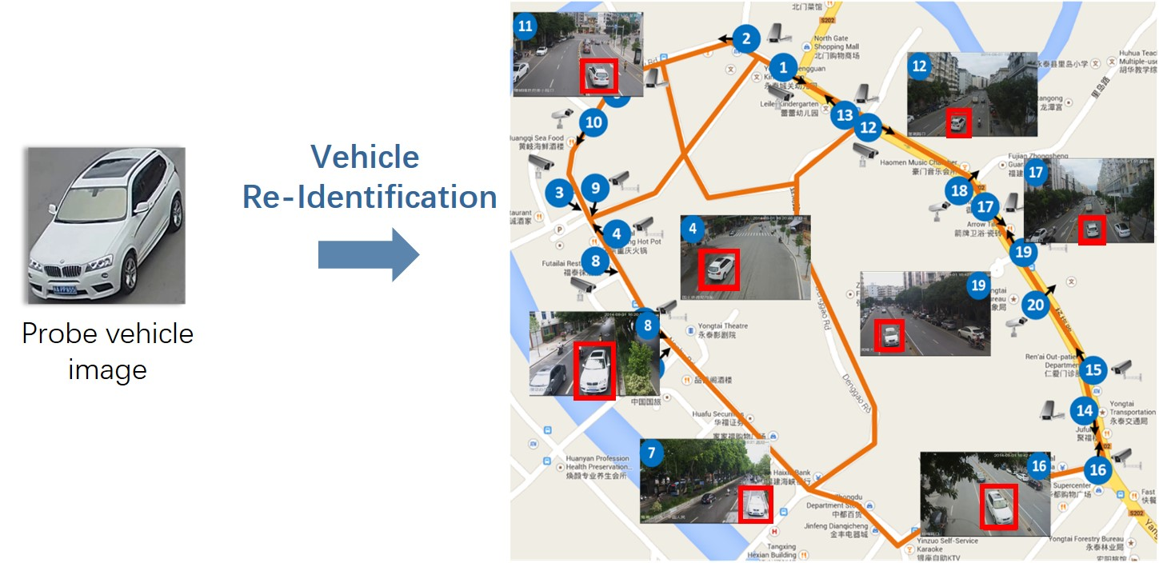
Task Definition
License Plate-Based Identification requires high-quality video recording and proper camera placement
Goal:
Develop a system to identify the most visually similar vehicle based on its features from a reference dataset.
Dataset:
PKU-VD
Contains ~15,000 diverse vehicle images.

Slide 3
Solution
Feature Extraction with ResNet50: Uses ResNet50 (pretrained) to extract feature vectors from around 15000 vehicle images.
Preprocessing: Resizes images to 224x224 and applies preprocessing before feature extraction.
Dataset Caching with Pickle: Saves extracted features and images in a pickle file for fast retrieval, so it only has to be done once.
Efficient Data Handling: Limits dataset size to 100 images and stores features for efficient comparison during tracking. (?)

Slide 4
Solution
Car Detection with YOLOv5: Detects cars in video frames using YOLOv5 with a confidence threshold of 0.8.
Vehicle Tracking with DeepSORT: Tracks vehicles across frames using DeepSORT, assigning unique IDs to each vehicle.
Real-Time Processing: Processes video frames in real time, displaying results while the video plays.
Similarity testing: Cosine similarity was used to match vehicles from the video to the ones in the dataset.

Slide 5
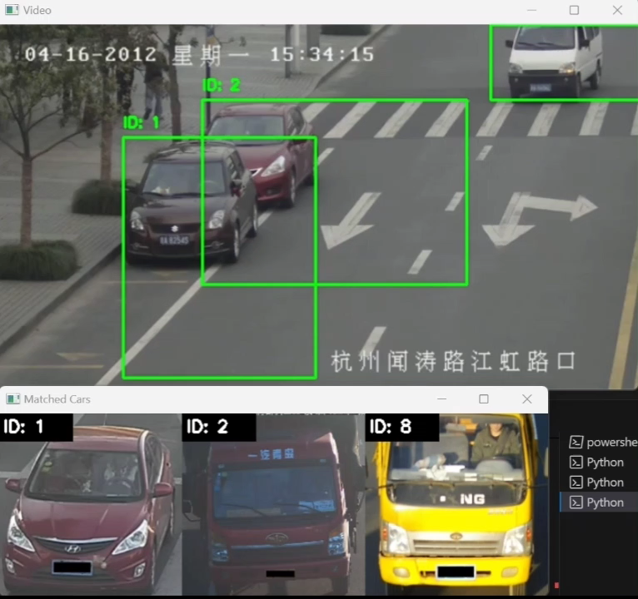
Experiments and qualitative evaluation results
All cars were correctly detected and almost perfectly tracked
Occlusion caused identification issues, one car's color being confused and the other car's model being misidentified
One misidentified car was later corrected
Failed with the last vehicle.

Slide 6
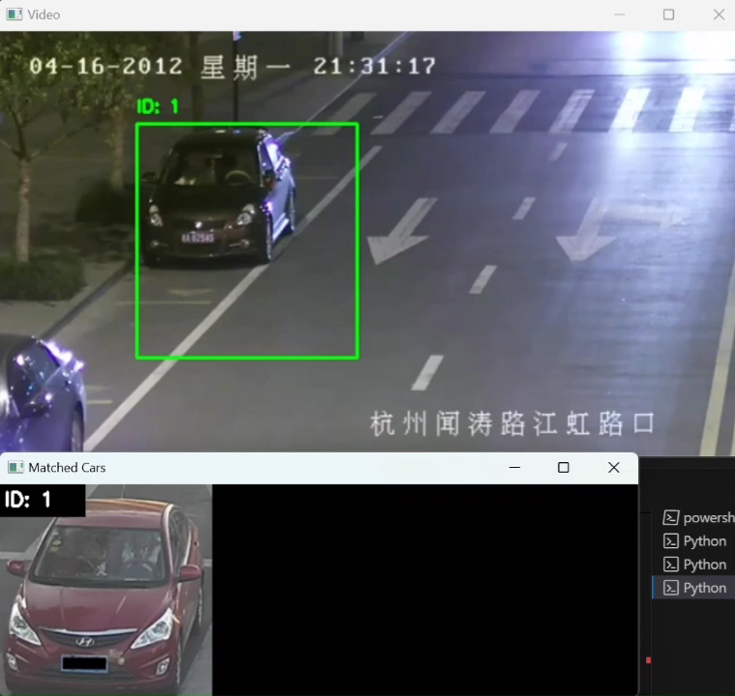
Experiments and qualitative evaluation results
Darkness and headlights affect identification
Most cars are not identified correctly.

Slide 7
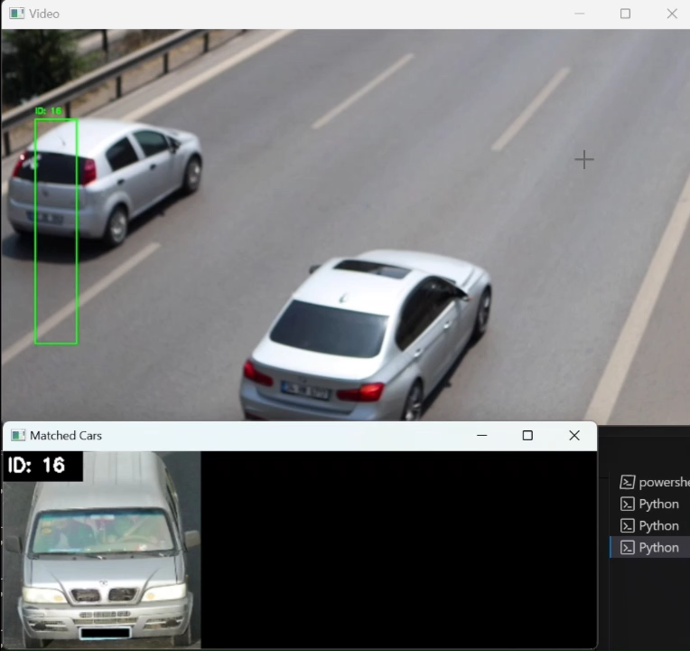
Experiments and qualitative evaluation results
Good performance
All vehicles well identified

Slide 8
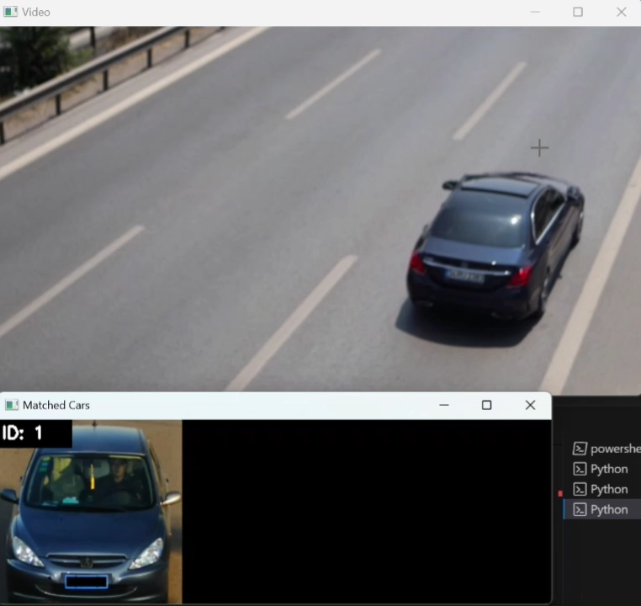
Experiments and qualitative evaluation results
Most are well detected and identified
Not being fully visible affects identification.

Slide 9
Main challenges
Time taken to process dataset features
Time Performance

Slide 10
Thank you

